Slide 2

Progress Towards Quantum Computing with Neutral Atom Arrays
Thesis Defense
Xiaoyu Jiang
Advisor: Mark Saffman
08/05/2022

Slide 3

Outline
Introduction
Laser noise analysis
Multi-qubit gate with neutral atoms
Surface code with neutral atoms

Slide 4
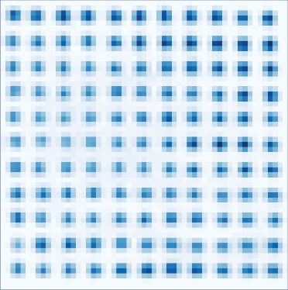
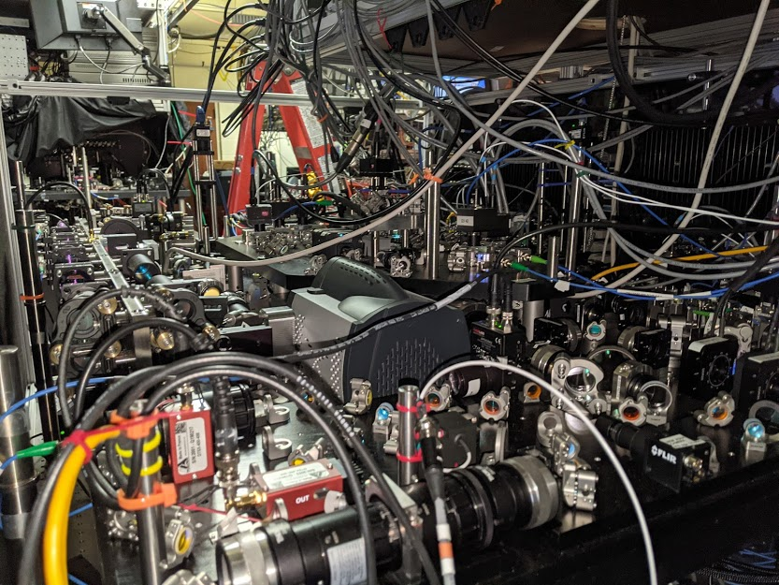
1. Introduction

Slide 5
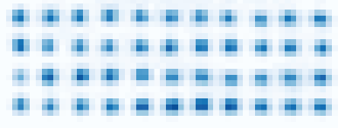
Quantum computing with neutral atoms
The atomic advantage: Isolation & Control
Laser cooled atoms trapped by light in vacuum.
Superb quantum memory with coherence from seconds to minutes.
Selective control using laser pulses
Excitation of Rydberg state provides super-strong interactions and fast logic operations at tens of nsec.
Superstrong interaction
in nanoseconds
Rydberg
atoms
Laser pulse
on/off ratio 10¹²
Neutral atoms trapped by light
Quantum properties maintained for seconds to minutes.

Slide 6

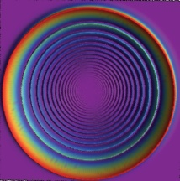
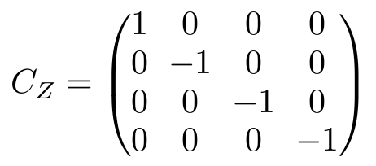
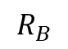
Rydberg blockade
$$R_{B}$$
Ω
ω_{q}
Ideal C_{Z} Gate
ω_{q}, B >> Ω >> 1/τ_{Ryd}
Jaksch, Dieter, et al. "Fast quantum gates for neutral atoms." Physical Review Letters 85.10 (2000): 2208.
Many other gate protocols are possible.
Saffman, M., et al. "Symmetric Rydberg controlled-Z gates with adiabatic pulses." Physical Review A 101.6 (2020): 062309.

Slide 7
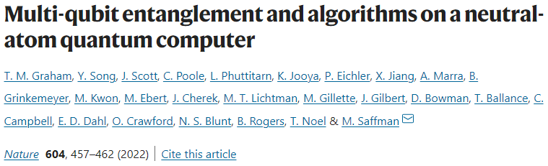
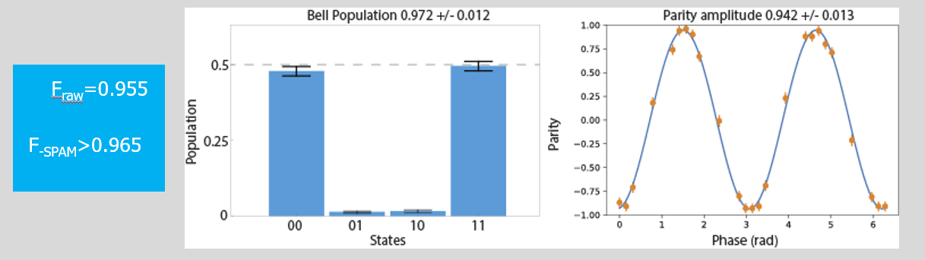
Recent results
Preparation of entangled GHZ states
Quantum phase estimation
Quantum approximate optimization algorithm (QAOA) for MaxCut graph problem

Slide 8
Main concern: low 2-qubit gate fidelity
Beam Shaping
Spectrum Filtering
Noise Analysis

Slide 9
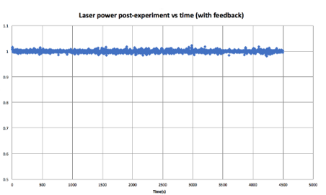
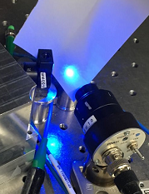
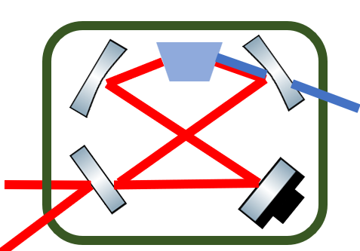
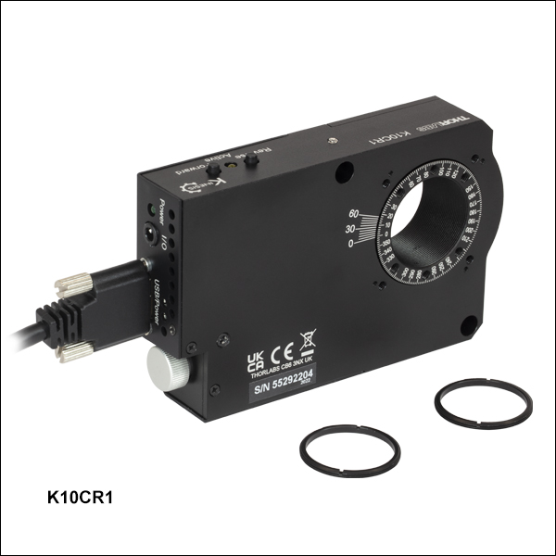
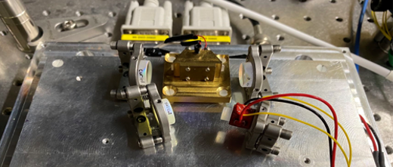
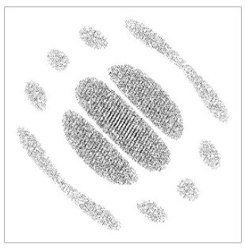
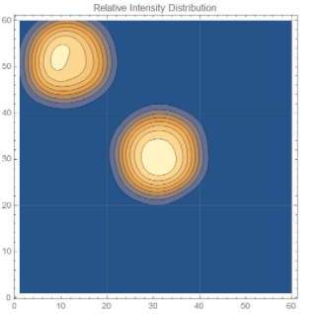
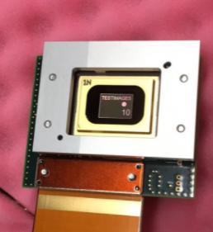
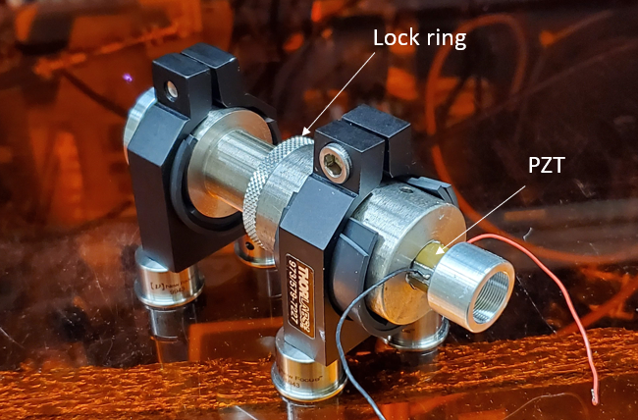
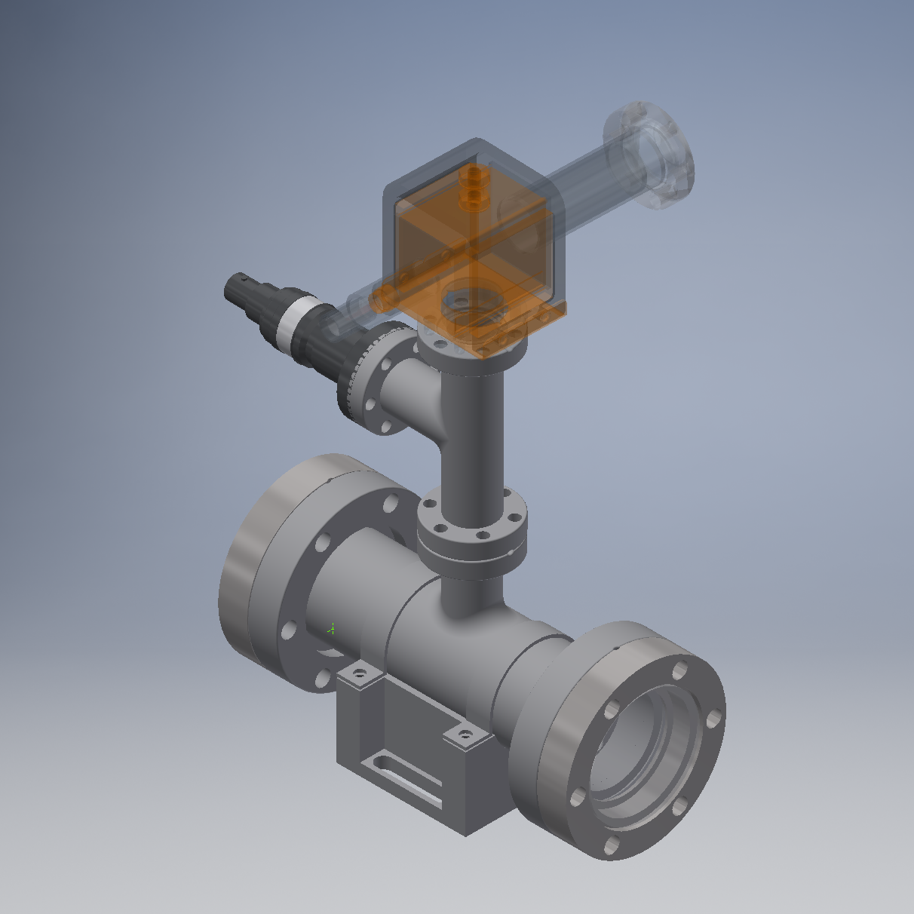
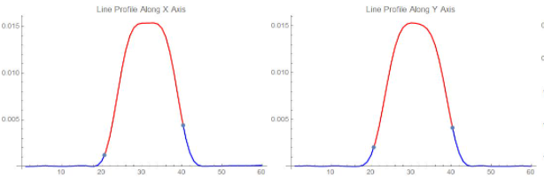
Experimental subsystem development
Laser power post experiment (with feedback)
Frequency Doubling
Laser Noise Eater
Beam Shaping with DMD
Hologram
Image Plane
Beam Profile
Filtering Cavity

Slide 10
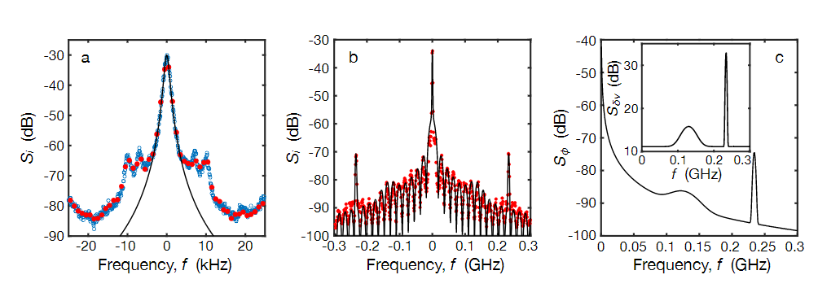
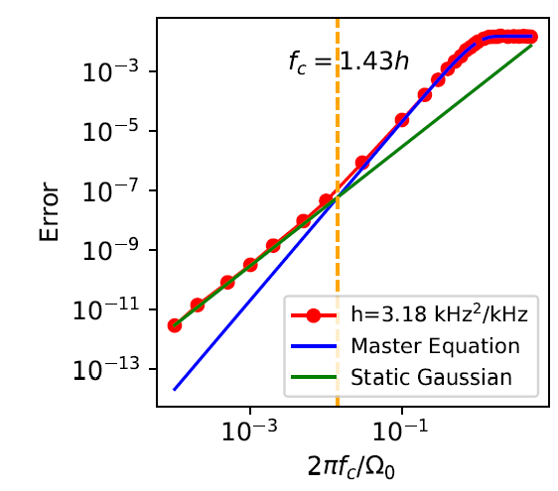
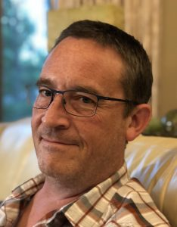
2. Laser noise analysis
Mark Friesen

Slide 11
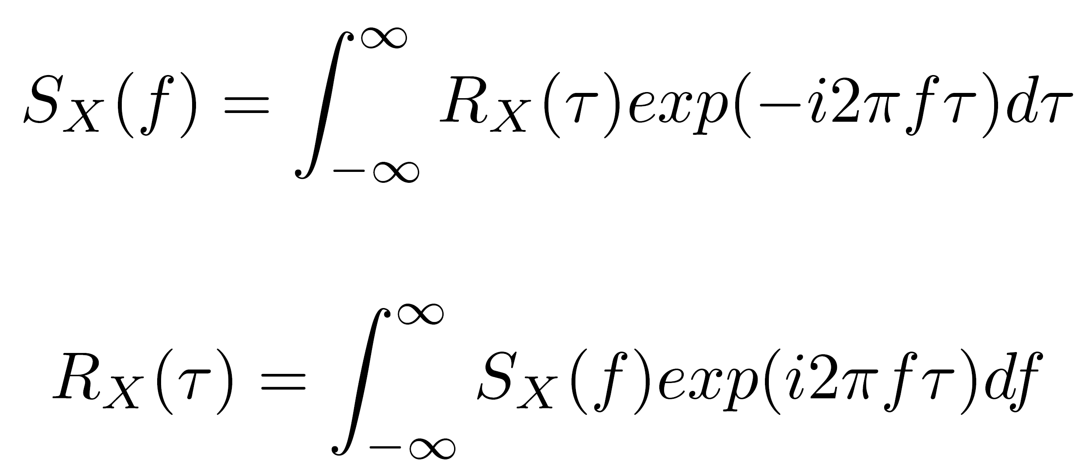
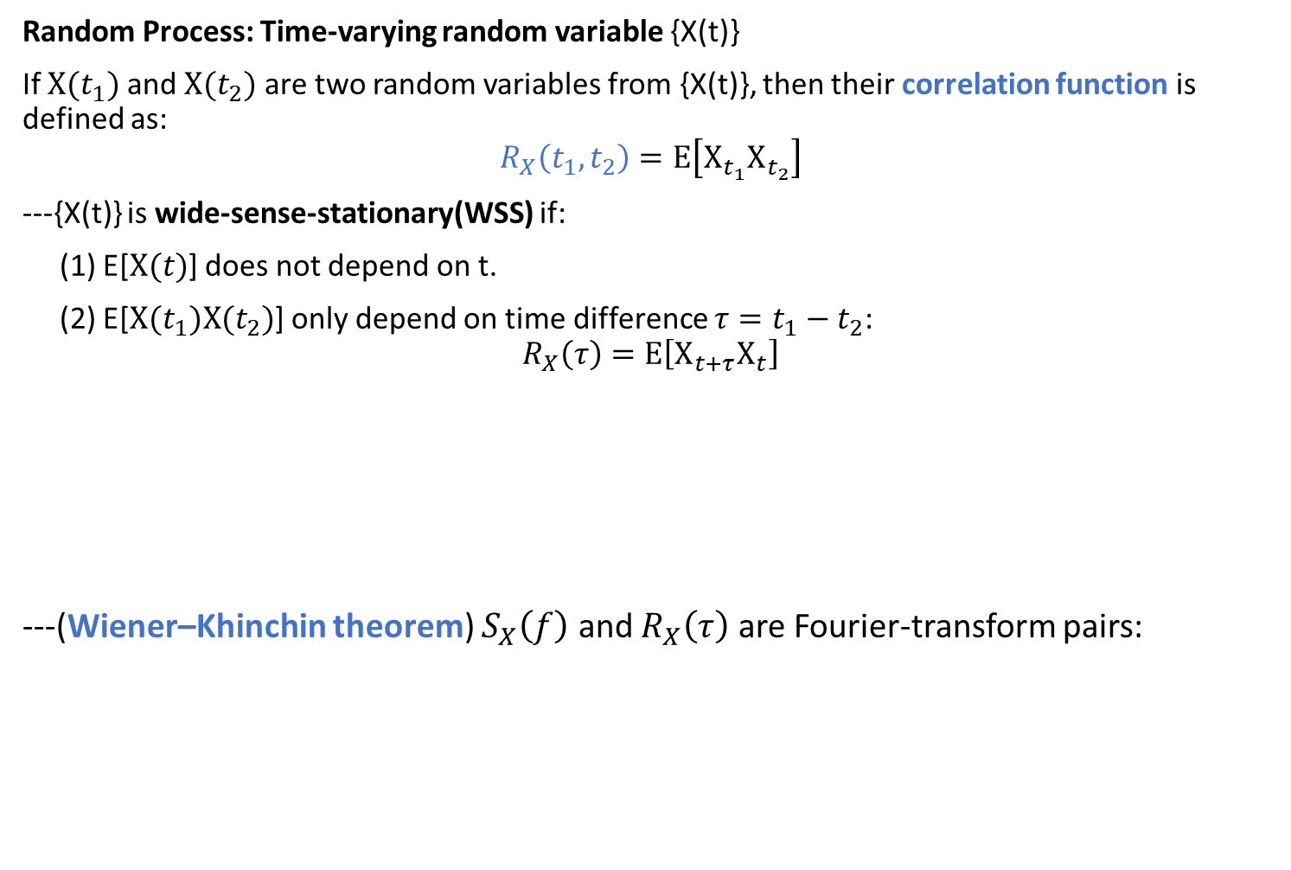
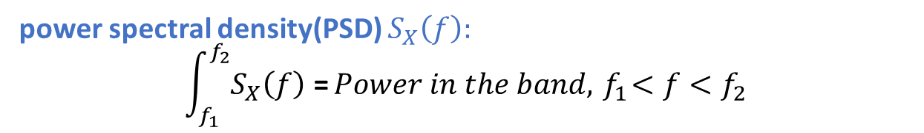
Random Process
Random Process: Time-varying random variable {X(t)}
If $X(t_{1})$ and $X(t_{2})$ are two random variables from {X(t)}, then their correlation function is defined as:
$$R_{X}\left(t_{1},t_{2}\right)=E\left[X_{t_{1}}X_{t_{2}}\right]$$
---{X(t)} is wide-sense-stationary(WSS) if:
(1) E[$X(t)$] does not depend on t.
(2) E[$X(t_{1})X(t_{2})$] only depend on time difference $τ=t_{1}−t_{2}$:
$$R_{X}\left(τ\right)=E\left[X_{t+τ}X_{t}\right]$$
---(Wiener–Khinchin theorem) $S_{X}\left(f\right)$ and $R_{X}\left(τ\right)$ are Fourier-transform pairs:
power spectral density(PSD) $S_{X}\left(f\right):$
$$\int_{f_{1}}^{f_{2}}{S_{X}\left(f\right)\text{ =}}Power in the band,{ f}_{1}<f<f_{2}$$

Slide 12
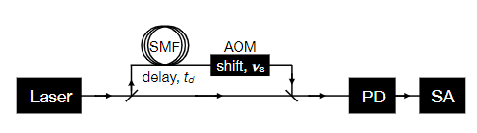
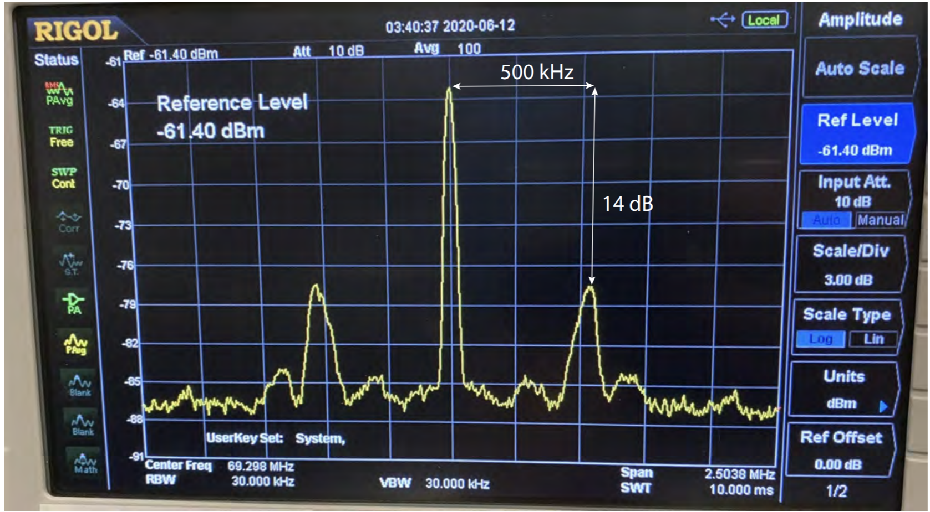
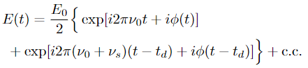
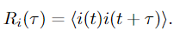
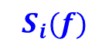
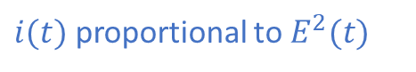
Self-heterodyne system
Self-Heterodyne System
Laser lineshape
$$S_{i}(f)$$
Unlocked
AOM: acouoptic modulator
PD: photodiode
SA: spectrum analyzer
SMF: single mode fiber
Locked
Servo bumps
Ideal Laser:
δ-function lineshape
In experiments:
Lineshape has finite width
Servo bumps
$i(t)$ proportional to $E^{2}(t)$

Slide 13
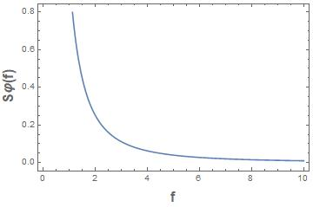
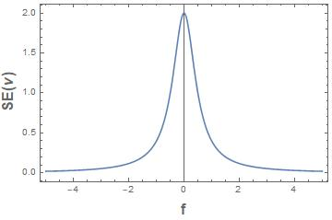
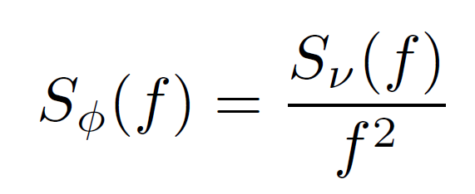
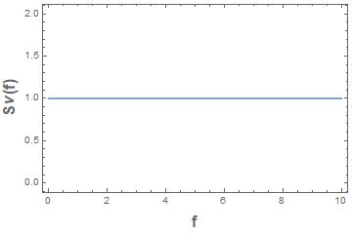
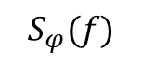

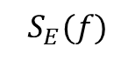
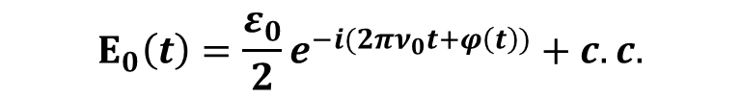
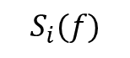
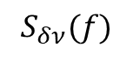
Example: frequency noise with Lorentzian lineshape
Laser Field:
$$Ε_{0}\left(t\right)=\frac{ε_{0}}{2}e^{−i(2πν_{0}t+φ\left(t\right))}+c.c.$$
$$S_{φ}(f)$$
$$S_{i}(f)$$
$$S_{E}(f)$$
$$S_{δν}(f)$$
Self-Heterodyne Spectrum
Carrier Spectrum
(Example: Lorentzian Lineshape)
$i(t)$ proportional to $E^{2}(t)$
Noise Spectrum for phase (above) and frequency (below) noise
G. Di Domenico, S. Schilt, and P. Thomann, “Simple approach to the relation between laser frequency noise and laser line shape,” Appl. Opt. 49, 4801 (2010)

Slide 14
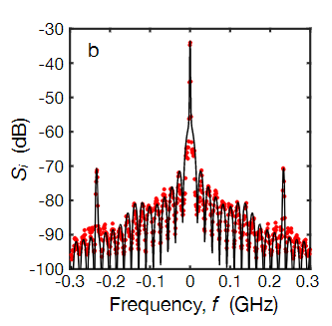
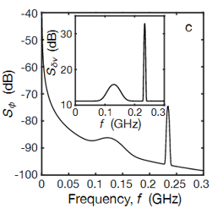
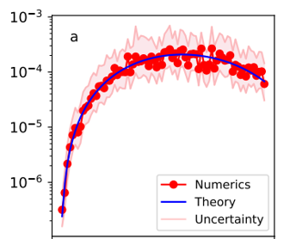
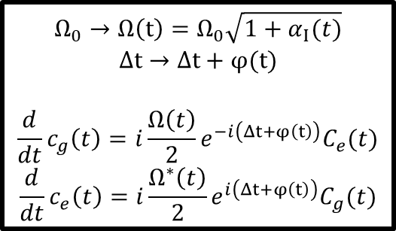
Steps on studying laser noise
Lab self-heterodyne measurements
step1
Frequency noise spectrum
Step2.1
Step2.2
Error calculated by simulation
Error predicted by theory
Quasi-static model
Time-series master equation
$$Ω_{0}→Ω\left(t\right)=Ω_{0}\sqrt{1+α_{Ι}(t)}$$
$$Δt→Δt+φ(t)$$
$$\frac{d}{dt}c_{g}\left(t\right)=i\frac{Ω\left(t\right)}{2}e^{−i\left(Δt+φ\left(t\right)\right)}C_{e}(t)$$
$$\frac{d}{dt}c_{e}\left(t\right)=i\frac{Ω^{∗}\left(t\right)}{2}e^{i\left(Δt+φ\left(t\right)\right)}C_{g}(t)$$
compare

Slide 15
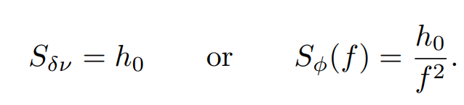
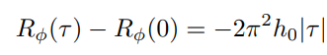
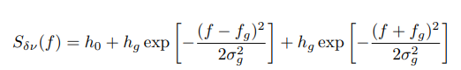
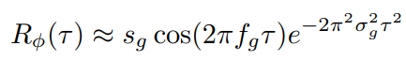
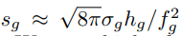
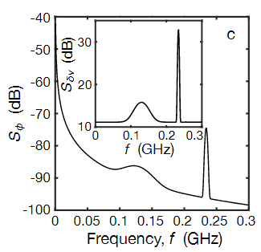







Two models of $S_{δν}\left(f\right)$
Parameter:
White noise:
$$h_{0}$$
White noise
Gaussian bump
Servo bump noise:
$$h_{0},h_{g},f_{g},σ_{g}$$
M. Zhu and J. L. Hall, “Stabilization of optical phase/frequency of a laser system: application to a com-mercial dye laser with an external stabilizer,” J. Opt.Soc. Am. B 10, 802 (1993)
$$S_{δν}(f)$$
Why these two spectrums?
White noise: $FWHM =h_{0}×π$
Servo bump noise: study the influence of servo bumps in self-heterodyne lineshapes
$$FWHM$$
$$S_{φ}(f)$$

Slide 16




$$S_{i}\left(f\right)→S_{δν}\left(f\right)$$
White noise
servo bump
noise

Slide 17









Numerical simulations
Population errors
$${N=Ω}_{0}t/2π$$
2π pulse,
N=1, 2, 3
One-photon, Δ=0, $Ω_{0}=Ω_{1}=1×2π ΜΗz$
Two-photon, Δ=0,
$${\tilde{Ω}}_{0}=1×2π ΜΗz$$
π pulse,
N=0.5,1.5, 2.5, …
Under some limits the intermediate level is not populated, effective ${\tilde{Ω}}_{0}=Ω_{1}Ω_{2}/δ$

Slide 18







Error prediction: Time series master equation
a: 1π pulse
b: 2π pulse
We consider a two-level system of frequency $ν_{0}$driven resonantly by a monochromatic laser, with Rabi angular frequency $Ω_{R}$:
Consider extracting $φ(t)$ from the noise spectrum $S_{δν}(f)$:
With master equation:
We get:
1 photon
White Noise
2 photon

Slide 19


Servo bump noise
1 photon
2 photon
a: 1π pulse
b: 2π pulse
1π
2π

Slide 20






Error prediction: Quasi-static model
When the bandwidth of the laser noise is much less than the Rabi Frequency Ω, we can treat the noise simply as a random variable(not time-varying) drawn from a Gaussian distribution with variance σ.
One photon transition with frequency noise:
$$S_{δν}(f)$$
Power Spectral Density
$$h_{0}$$
$$f_{c}≪Ω_{0}$$
f
1 photon
2 photon

Slide 21


Comparison: Numerics and Theory
Quasi-static theory, 1 photon
2 photon
Bandwidth=0.01 Ω
a: 1π pulse
b: 2π pulse
Linewidth (kHz)
Linewidth (kHz)

Slide 22





Band-limited “white" noise
$$S_{δν}(f)$$
Power Spectral Density
With time series method, without approximation:
$$h_{0}$$
$$f_{c}$$
Finite Bandwidth
For 1-photon band-limited noise, we can compare the two methods:
2π pulse
Infinite Bandwidth

Slide 23

Error vs bump power
a: 1π pulse
b: 2π pulse
Error vs Fractional power in the servo bump
Next step: experiment with microwaves

Slide 24









Intensity Noise
$$S_{αI}(f)$$
Power Spectral Density
Can be numerically simulated given $S_{αI}\left(f\right).$
$$f_{c}$$
f
Quasi-static Theory:
1π
1π
$$error=\frac{N^{2}π^{2}σ^{2}}{4}, N=\frac{Ω_{0}t}{2π}$$
2π
2π
$$f_{c}=0.1Ω_{0}$$
$$f_{c}=10Ω_{0}$$

Slide 25




3. Mulit-qubit Gate with Neutral Atoms
Matthew Otten

Slide 26




Mulit-qubit gate with neutral atoms
Quantum Computation: single qubit and CNOT gates are universal.
Large number of qubits
High fidelity universal gate set
$C_{3}Z$gate
Decomposing a multi-qubit gate into the universal set is not always efficient.
Example:
6 CNOT gates are needed to construct a Toffoli gate
Example:
20 CNOT gates are needed to construct a $C_{3}Z$gate
Cost: error, time

Slide 27



$C_{2}Z$ gate
Requires equal all-to-all coupling
$$R_{B}$$

Slide 28


$C_{3}Z$ gate

Slide 29


$C_{4}Z$ gate

Slide 30
ARP pulse
“Symmetric” CZ gate
ARP pulses with detuning change halfway through.
Truth table:
Optimized ARP pulses can give F>0.999.
Integrate master equation:
|00> |00>
|01> -|01>
|10> -|10>
|11> -|11>
Saffman, M., et al. "Symmetric Rydberg controlled-Z gates with adiabatic pulses." Physical Review A 101.6 (2020): 062309.

Slide 31





$C_{k}Z$ gate
Numerical Simulations:
Calculate $C_{k}Z$gate fidelity with initial pulse parameters
Optimize single qubit rotation phases.
Optimize pulse parameters. For each set of pulse parameter, repeat optimization on single qubit phases.
Reich, Daniel M., Giulia Gualdi, and Christiane P. Koch. "Minimum number of input states required for quantum gate characterization." Physical Review A 88.4 (2013): 042309.

Slide 32




$C_{k}Z$ gate
$C_{k}Z$gate fidelity at different k and coupling strengths
Robustness test by making coupling strength varies in range $(Min\left(B\right)=B_{0}−δB,B_{0}+δB)$

Slide 33



$${CZ}_{k} gate$$
${CZ}_{k} gate$ is equivalent to k parallel $CZ$ gates
Requires equal coupling between every control-target pair
Requires 0 coupling between target-target pair
Single Gaussian pulse gate:
Possible Geometry
Target
Control
or
Can give F>0.999
Robicheaux, Francis, T. M. Graham, and Mark Saffman. "Photon-recoil and laser-focusing limits to Rydberg gate fidelity." Physical Review A 103.2 (2021): 022424.

Slide 34





$${CZ}_{k} gate$$
${CZ}_{k}$gate fidelity at different k and coupling strengths
Robustness with finite target-target coupling strengths, as a percentage of control-target coupling

Slide 35



4. Surface code with neutral atoms
Matthew Otten

Slide 36





Surface code with neutral atoms
Surface code
● Error-correcting code that uses many physical qubits into a smaller number of logical qubits.
Example:
single (qu)bit-flip error channel
Classical:
Three qubit bit flip code:
Encode
Error
Decode
Correction
Logical Qubits

Slide 37



Surface code
Surface code
● Applies stabilizer measurements to detect syndromes:
white dots: data qubits
black dots: measurement qubits
In one stabilizer measurement, there are
four C-NOTs and one projective measurements on the measurement qubit(syndrome).
Every round of stabilizer measurement is completed over the whole array before the next round begins.

Slide 38

Surface code
● Quiescent state of the stabilizer:
The quiescent state is random selected after 1st round of stabilizer measurements, but is then maintained, unless there is error.

Slide 39


Surface code with neutral atoms
Advantages:
· Scalable and Reconfigurable
· Two-Species configuration suppresses crosstalk between data and ancilla qubits

Slide 40



Multi-qubit gate
Can be implemented with a single ${CZ}_{k}$ gate

Slide 41



Single plaquette test
Simulation results using QuaC for stabilizer detection on a single 5 atom plaquette
QuaC (Quantum in C) is a parallel time dependent open quantum systems solver.
Can be used on large, multi-core computers
Matthew Otten
Single Gaussian pulse gate

Slide 42


Surface code operations
Example: Surface-13 code
● Each round of stabilizer measurements gives a map of syndromes.
● Keep repeating to get a time series of syndrome maps.
● Decode from the syndrome maps to see which qubit is affected by error
● Apply error correction
Z measurement
X measurement

Slide 43

1
Decoder
Surface code
9
10
Choosing a decoder…
Z error
4
5
6
What could have happened:
● in 2: more likely
● X error in 1 and 3
11
12
7,8
9
1,4
3
2
9
10
5
X error
Decoder:
● Small codes like surface 13: Look-up table
● Larger codes: Minimum weight perfect matching, etc(dependent on noise type)
11
8
12
7
6,9

Slide 44
Future study:
Whole s-13 simulation
Implementing multi-qubit gate on surfacecode

Slide 45




Acknowledgements - Thank you!
AQuA/RbCs Guys:
Garrett Hickman
Kais Jooya
Ravi Chinnarasu
Yunheung Song
Cody Poole
Jacob Scott
Sam Norrell
Linipun Phutittarn
Alphonse Marra
Brandon Grinkemeyer
Samuel Cieszynski
Genevieve Kearns
Fellow Graduate Students:
Christopher Yip
Christopher Young
Juan Bohorquez
Preston Huft
Eunji Oh
And everyone in the Saffman Group!
Mark Saffman
Mark Friesen
Matthew Otten
Trent Graham
Matthew Ebert
Minho Kwon

Slide 46


Shjiazhuang
Hefei
Wuhan
Shenzhen

Slide 48


Slide 49






The Effect of White Noise on T2 time
With mathematical properties of the white noise, we have:
$$S_{δν}(f)$$
$$h_{0}$$
1-photon
infinite bandwidth
2-photon
1-photon
2-photon

Slide 50
The “undersample problem” in the time domain exists for both high- and low-bandwidth noises.
Our current scheme:
Generate one sample of the time series and do one round of numerics with the sample
Repeat 1 for multiple times, generating a new time series sample each time.
Take average
Should we…… ?
Generate one sample of the time series and do multiple round of numerics with this sample. Then take the average.
Repeat 1 for multiple times, generating a new time series sample each time.
Take average from different time series.

Slide 51



Generated sample time series
(sample A)
A sample of
phase noise φ(t)
2π/Ω
$$t_{0}$$
$$t_{0}+2π/Ω$$
Τ
2Τ
t
1. Assume the above sample is sample A. It is calculated by:$φ\left(t_{k}\right)=\sum_{j=1}^{M/2}{\sqrt{\left\{2S_{φ}^{1−sided }\left(f_{j}\right)Δf\right\}cos\left(2πf_{j}t_{k}+φ_{j}\right)}}$. $φ_{j}$is the random phases. We first followed our current scheme to simulate the system between$(0, \frac{2π}{Ω})$.
2. In order to get the full information of sample A, we now want to simulate the time series in ${(t}_{0}, t_{0}+\frac{2π}{Ω})$. In this case, it is equivalent to simulate a new sample(sample B) between $\left(0, \frac{2π}{Ω}\right)$ with function $φ\left(t_{k}\right)=\sum_{j=1}^{M/2}{\sqrt{\left\{2S_{φ}^{1−sided }\left(f_{j}\right)Δf\right\}cos\left(2πf_{j}t_{k}+{φ_{j}}^{′}\right)}},{φ_{j}}^{′}=φ_{j}+2πf_{j}t_{0}$
3. This is to say, if we are lucky and have a sample B with random phases equals to ${φ_{j}}^{′}$s, then the numerics with step 1 in our current scheme for sample B is equivalent running sample A in time slot ${(t}_{0}, t_{0}+\frac{2π}{Ω})$.
4. The conclusion is, running each sample with one round of numerics is equivalent to sampling all the information from every sample, if we can run many cases for averaging. This is to say our current scheme is OK.

Slide 52






Surface code
● Logical qubits:
41 data qubits=41×2 degrees of freedom.
40 measurement qubits=40×2
restrictions.
2 additional degrees of freedom to define a logical qubit.
One can define:
as the operations on the logical qubit.

Slide 53

Surface code operations
Example: Surface-13 code
● Each round of stabilizer measurements gives a map of syndromes.
● Keep repeating to get a time series of syndrome maps.
● Decode from the syndrome maps to see which qubit is affected by error
● Apply error correction

Slide 54

Future study:
Whole plaquette simulation
Implementing multi-qubit gate on surfacecode
Repumping scheme for leakage errors
A pair of π polarized optical fields couple 6s1/2,f= 3 to 6p1/2,f′= 3, and 6s1/2,f= 4 to 6p1/2,f′= 4.

Slide 55



